Slide 1
THE CITY OF ZAGREB
Made by: Patricia & Lucija

Slide 2
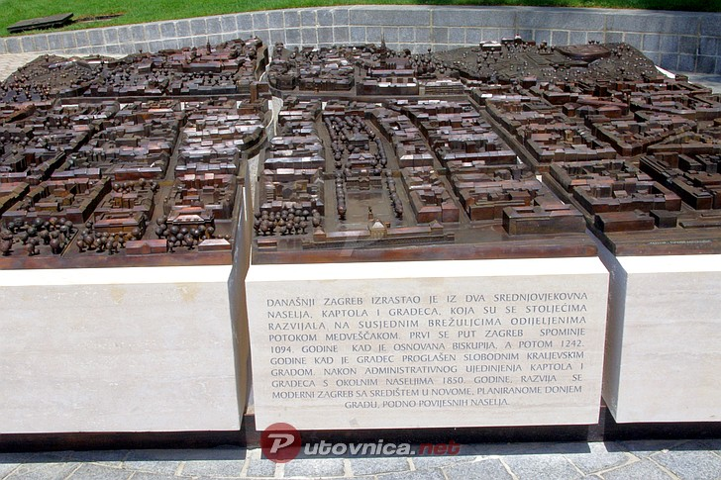
About Zagreb
Zagreb is the capital city of Croatia
It has 801.349 citizens (2015.)
The surface of Zagreb is 641 km²
The mayor is Milan Bandić

Slide 3
Places to visit in Zagreb
Ban Jelačić square
Ilica street
Funicular
Cathedral of Zagreb
Medvedgrad (nature park)
HNK- Croatian national theatre
Botanical garden
and many others…

Slide 4
Ban Josip Jelačić square
is the central square of the city of Zagreb, Croatia, named after ban Josip Jelačić. The official name is Trg bana Jelačića. The square is colloquially called Jelačić plac.
It is located below Zagreb's old city cores Gradec and Kaptol and directly south of the Dolac Market on the intersection of Ilica from the west, Radićeva Street from the northwest, the small streets Splavnica and Harmica from the north, Bakačeva Street from the northeast, Jurišićeva Street from the east, Praška Street from the southeast and Gajeva Street from the southwest.

Slide 5
Ilica street
The longest street in Zagreb
It starts at ban Jelačić square
It is one of the main traffic streets in Zagreb

Slide 6
Funicular
The Zagreb funicular is a cable car connecting Zagreb upper and Lower Towns
The funicular has two cars for 28 passengers each (16 seated and 12 standing places). It runs at a speed of 1.5 m/s (4.9 ft/s), requiring 64 seconds to cross the distance. Its rides are scheduled every 10 minutes every day from 6:30 to 24:00.

Slide 7
Cathedral of Zagreb
The Zagreb Cathedral on Kaptol is a Roman Catholic institution and not only the tallest building in Croatia but also the most monumental sacral building in Gothic style southeast of the Alps. It is dedicated to the Assumption of Mary and to kings Saint Stephen and Saint Ladislaus. The cathedral is typically Gothic, as is its sacristy, which is of great architectural value. Its prominent spires are considered to be landmarks as they are visible from most parts of the city.

Slide 8
Medvedgrad
Medvedgrad is a medieval fortified town located on the south slopes of Medvednica mountain, approximately halfway from the Croatian capital Zagreb to the mountain top Sljeme. For defensive purposes it was built on a hill, Mali Plazur, that is a spur of the main ridge of the mountain that overlooks the city. On a clear day the castle can be seen from far away, especially the high main tower. Below the main tower of the castle is Oltar Domovine (Altar of the homeland) which is dedicated to Croatian soldiers killed in the Croatian War of Independence.

Slide 9
Church of saint Mark
The Romanesque window found in its south facade is the best evidence that the church must have been built as early as the 13th century as is also the semicircular ground-plan of St. Mary's chapel
Outside, on the northwest wall of the church lies the oldest coat of arms of Zagreb with the year 1499 engraved in it (the original is kept in the Zagreb City Museum).

Slide 10
Croatian national theatre
The Croatian National Theatre in Zagreb (Croatian: Hrvatsko narodno kazalište u Zagrebu), commonly referred to as HNK Zagreb, is a theatre, opera and ballet house located in Zagreb.
At the entrance of the theatre is located the wall fountain The Source of Life (Zdenac života), designed by Croatian artist and sculptor Ivan Meštrović in 1905.

Slide 11
Botanical garden
The Zagreb Botanical Garden (Croatian: Botanički vrt u Zagrebu) is a botanical garden located in downtown Zagreb, Croatia. Founded in 1889 by Antun Heinz, Professor of the University of Zagreb, and opened to public in 1891, it is part of the Faculty of Science. Covering an area of 5 hectares, the garden is situated at an altitude of 120 metres (390 ft) above sea level It is home to over 10,000 plant species from around the world, including 1,800 exotic ones. It has large ponds for aquatic plants. Some of Slava Raškaj's most notable works were painted by the garden ponds.

Slide 12
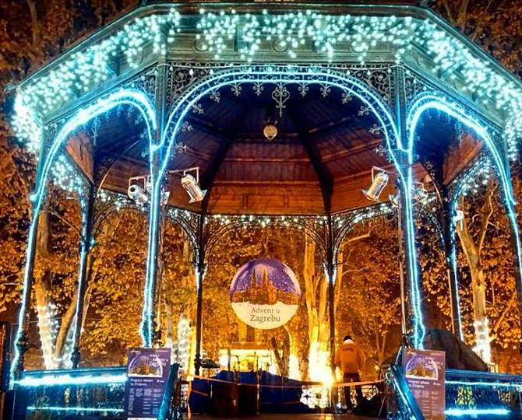
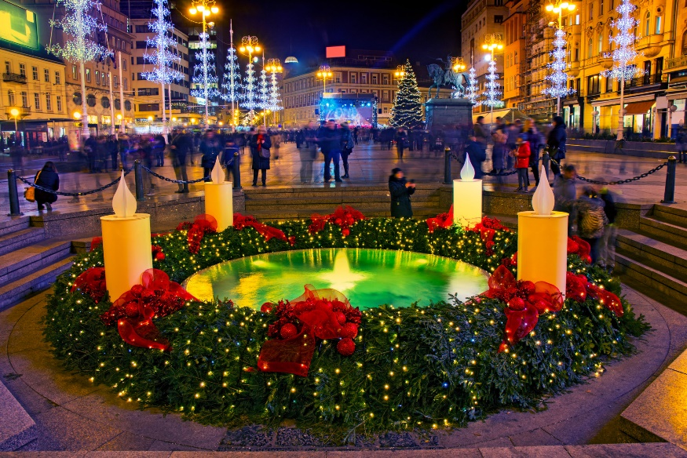
Advent in Zagreb

