Slide 1
British schools

Slide 2
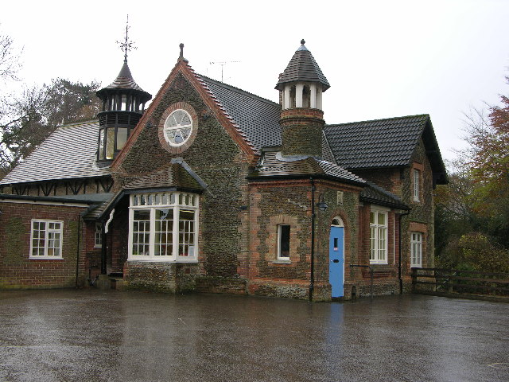
Primary school
Children start it when they are five and finish it around eleven

Slide 3
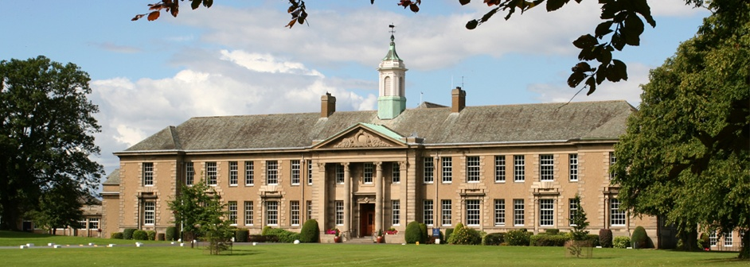
Secondary school
After primary school children go to secondary school
It lasts from age 12 to age 16

Slide 4
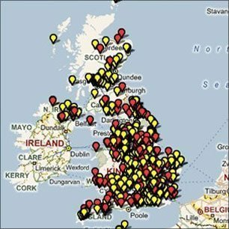
Map of schools in uk

Slide 5
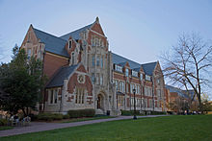
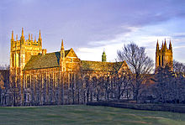
College/university
Some children continue their education and go to an university
The most famous universties are Oxford and Cambridge
Asnes Scott College
Boston university

Slide 6
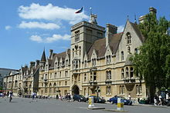
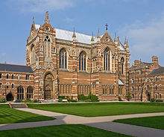
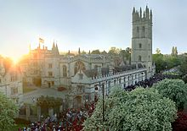
Oxford
The University of Oxford is one of the leading universities in the world.
Oxford is a city where there are a lot of different colleges
Magdalen Collage
Balliol college
Chapel of Keble College

Slide 7
Cambridge
Cambridge is an university town
The University of Cambridge is one of the oldest universities

Slide 8
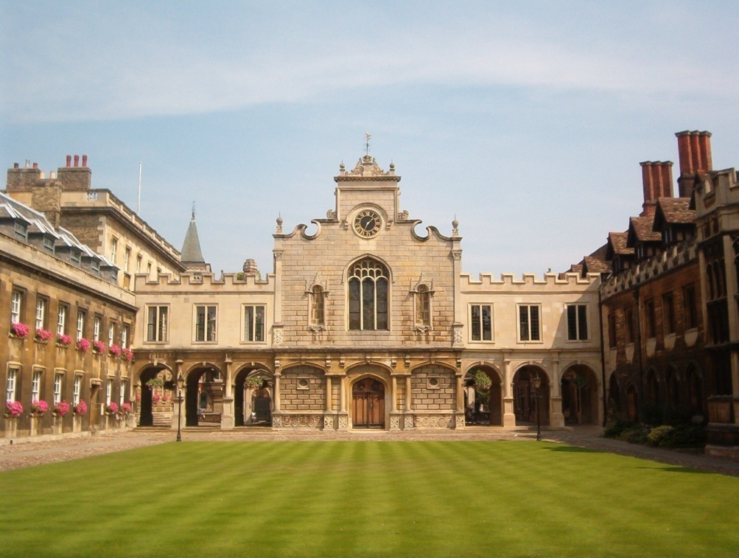
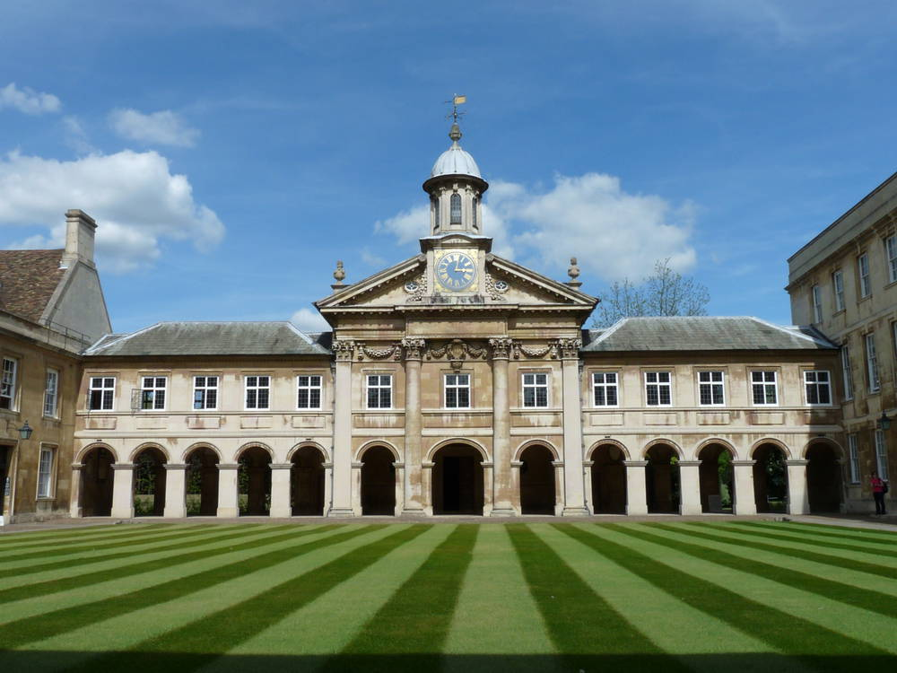
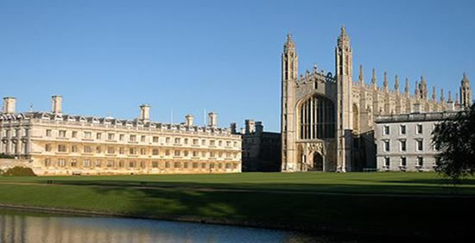

Slide 9
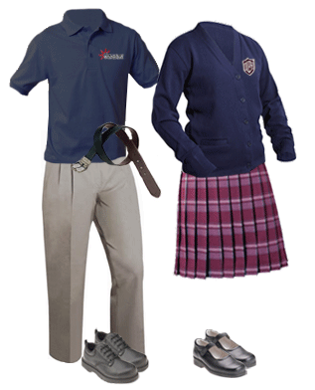
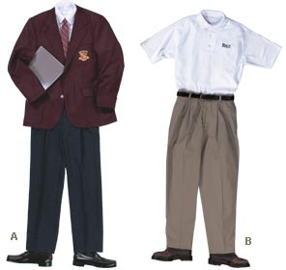
uniforms
Children in schools wear uniforms

Slide 10
sports
In British schools they play a lot of sport: soccer, rugby, cricket…

Slide 11
documentary
http://www.youtube.com/watch?v=wH_xy3uLbqE

Slide 12
The end
Thank you for watching and listening
MATEJ ŽAJA
LUKA ČAČIĆ
6.d OŠ BUKOVAC

