Slide 1
SHOPS IN GREAT BRITAIN

Slide 2
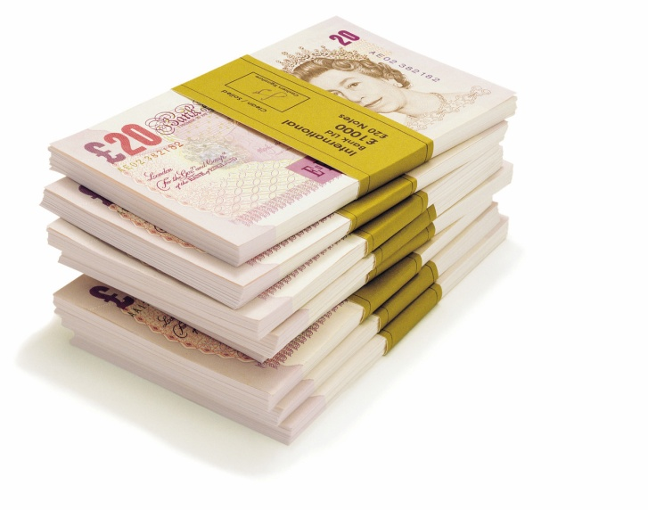

POUNDS AND PENCE
If you want go shopping in Britain, you need to change money, because POUNDS and PENCE are the British money.

Slide 3
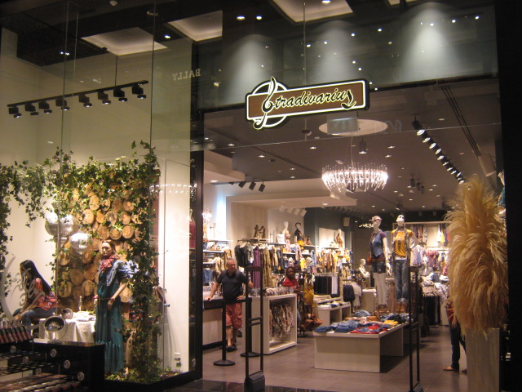
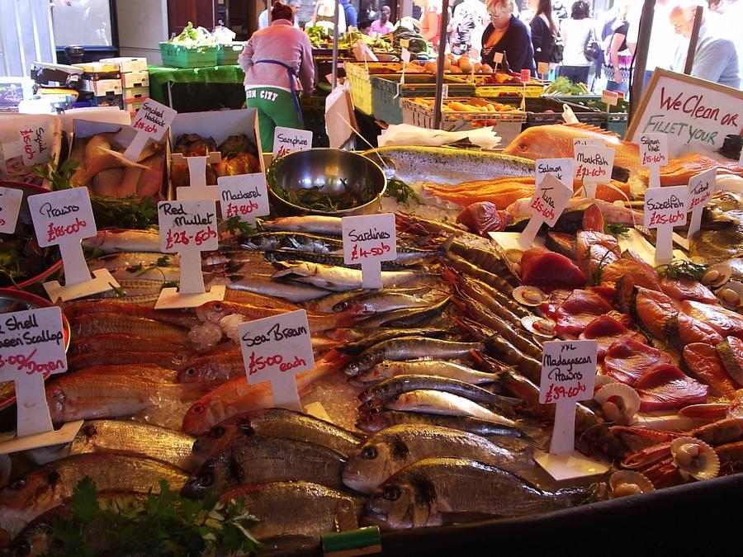
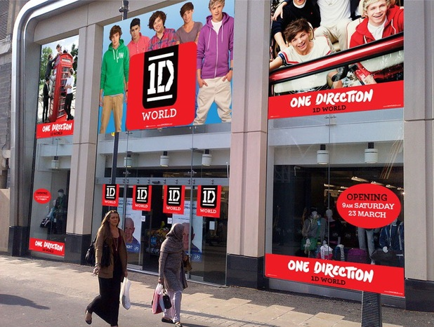
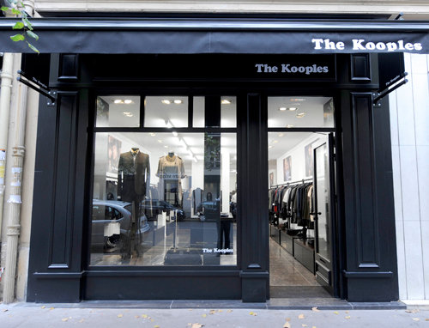

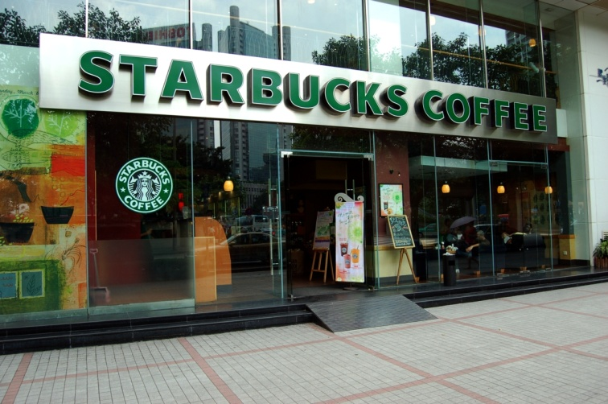
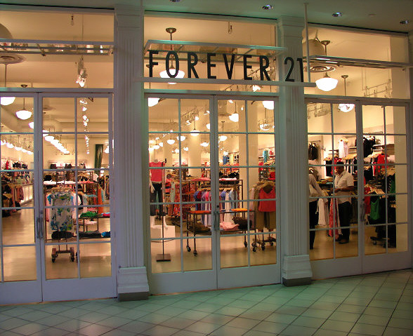
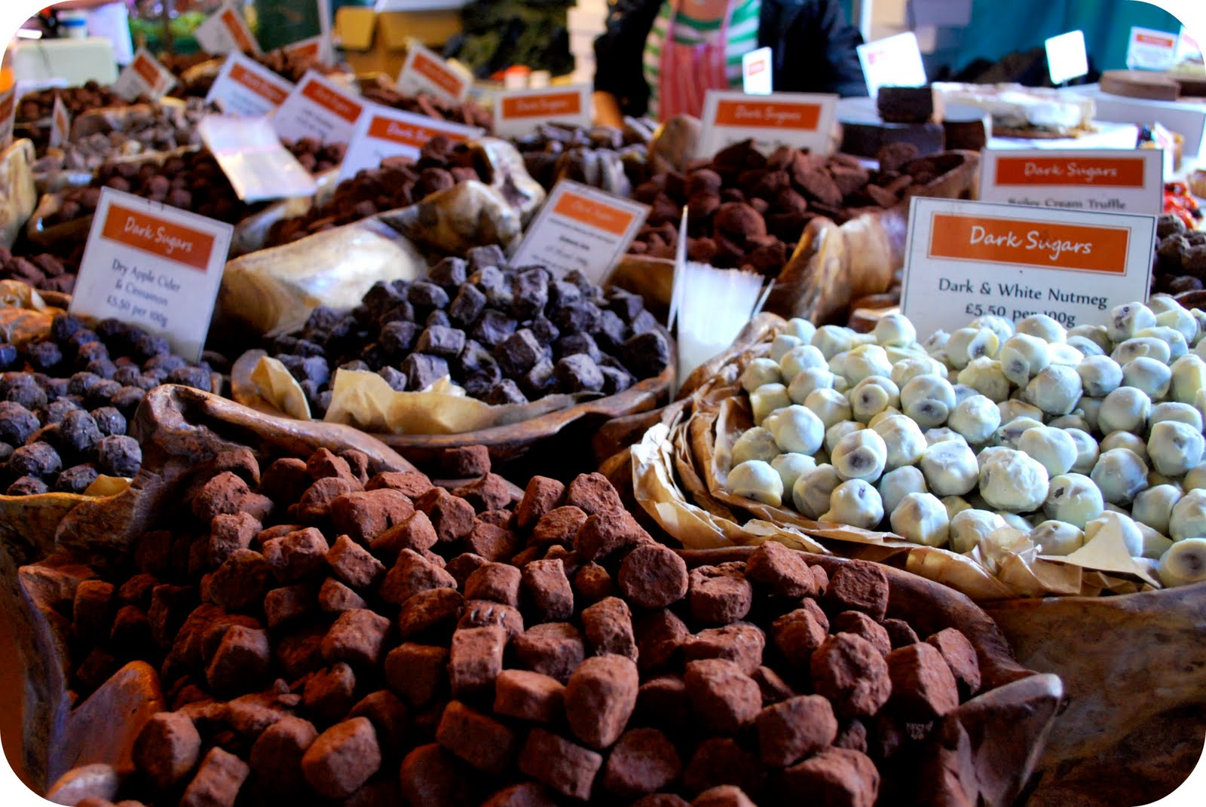

Slide 4
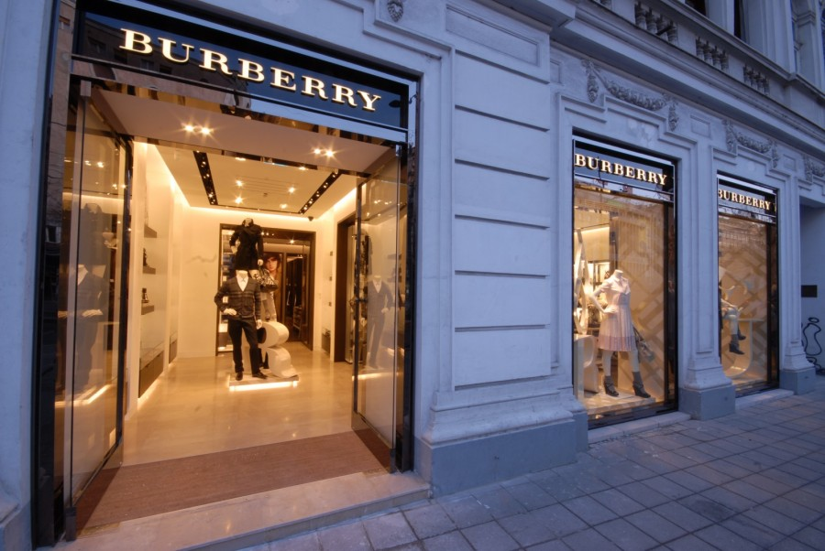
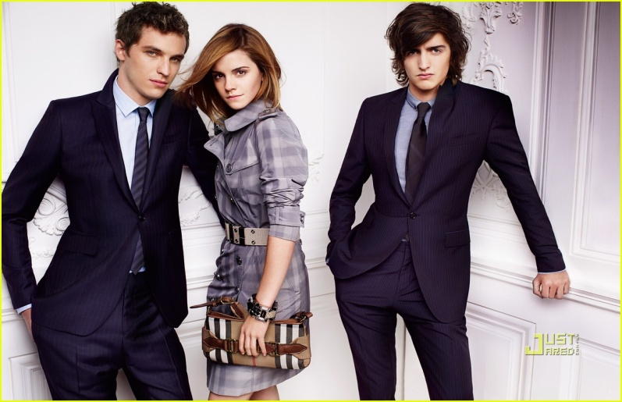
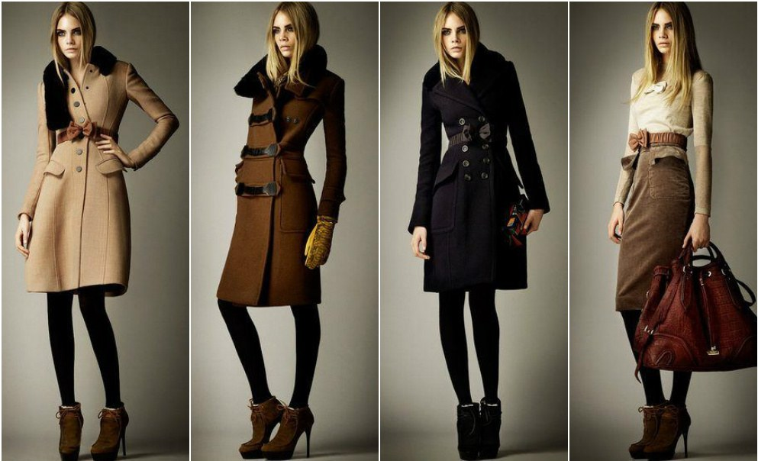
BURBERRY
Burberry Group is a British fashion house, distributing clothing, fashion accessories and cosmetics.

Slide 5
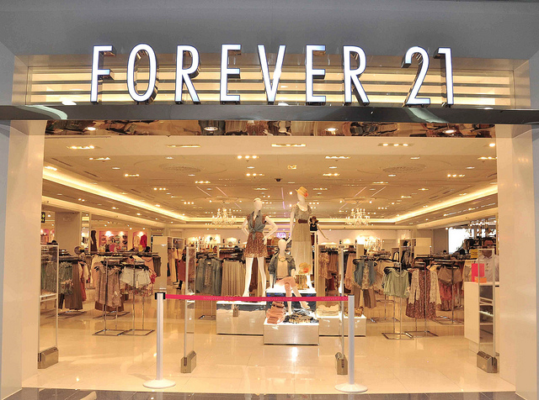
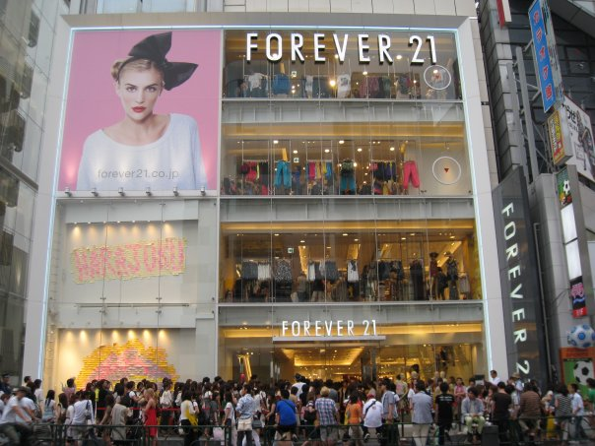

FOREVER 21
FOREVER 21 is famous fashion store

Slide 6
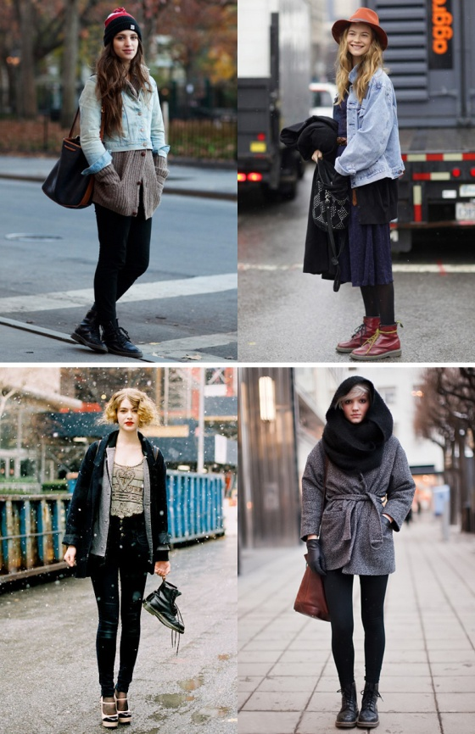
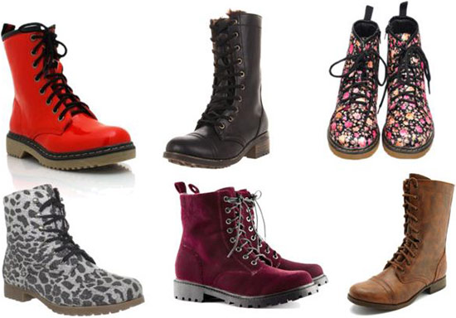
DR. MARTENS
Dr. Martens is a British footwear brand, which also makes a range of accessories – shoe care products, clothing…

Slide 7
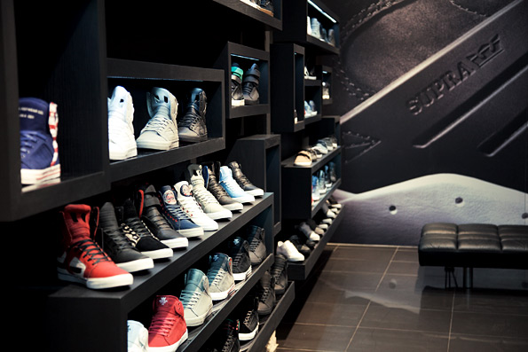
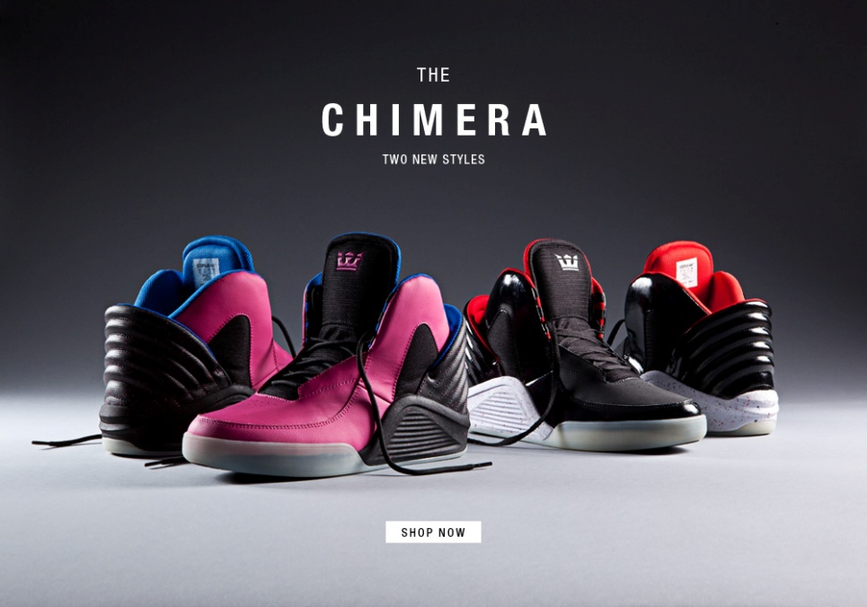
SUPRA
Supra footwear is made in UK
It is famous brand and it has a stores all around the world

Slide 8
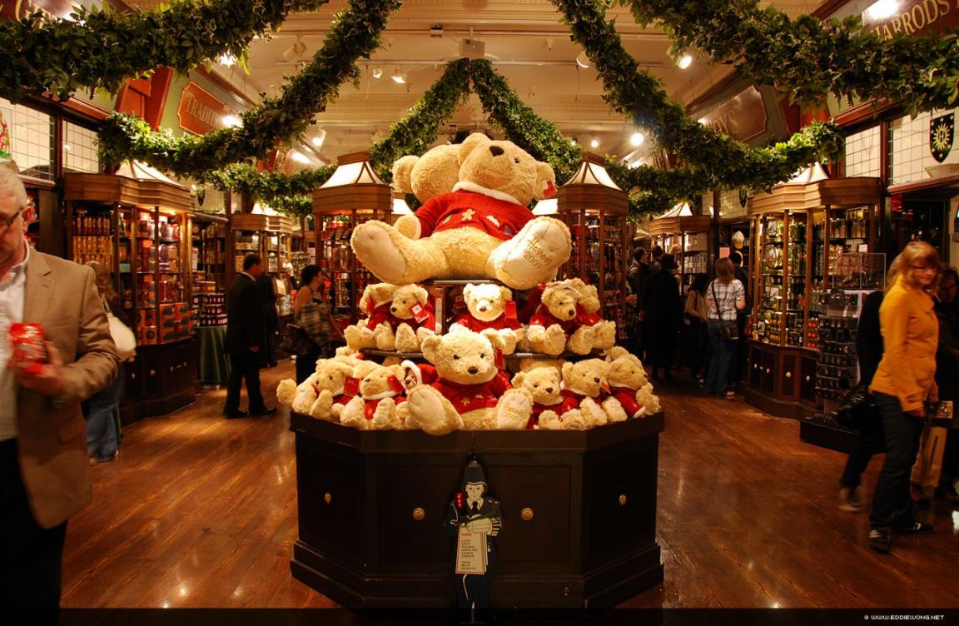
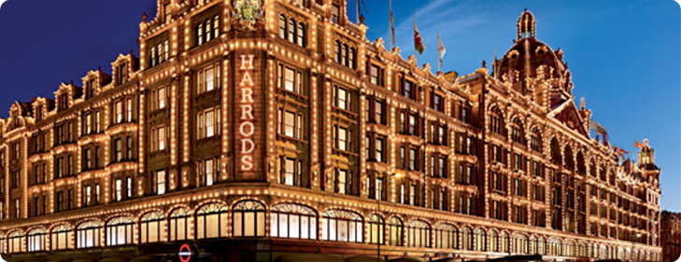
HARRODS
Harrods is the world's most famous department store

Slide 9

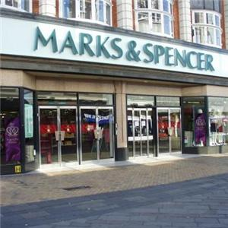
Marks & Spencer
Marks & Spencer also known as M&S is a British shop
There are 703 M&S shops around United Kingdom

Slide 10

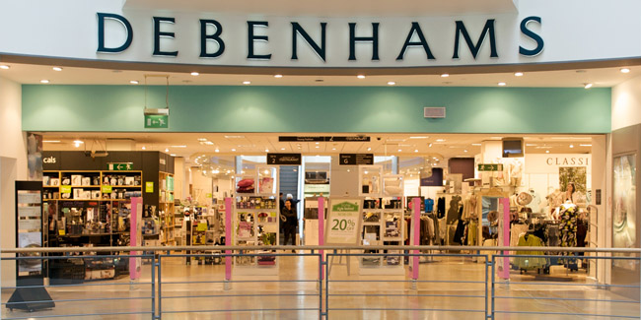
DEBENHAMS
Debenhams is a British store
The bussines was formed in 1778.

Slide 11
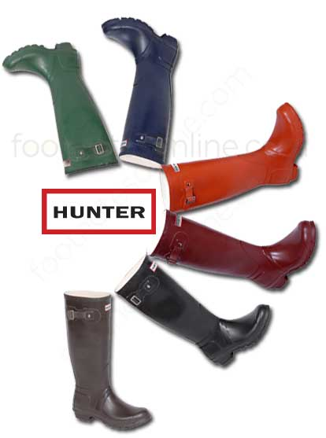
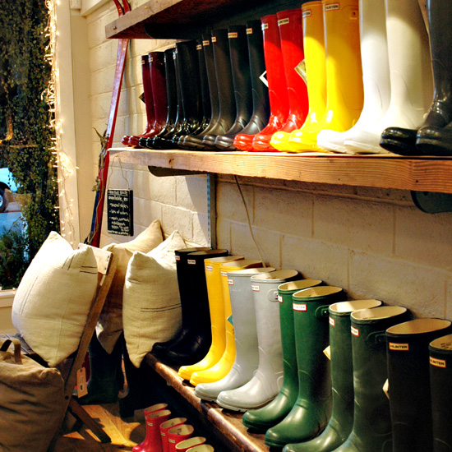
HUNTER
Hunter boot is a footwear founded in Edinburgh, Scotland

Slide 12
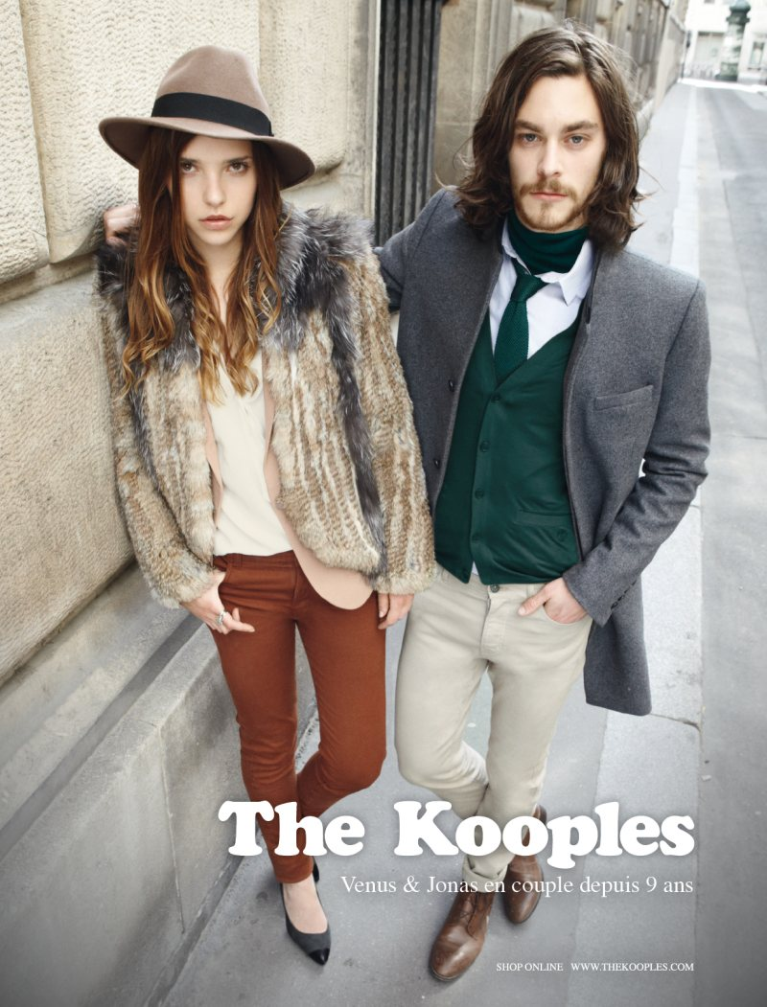
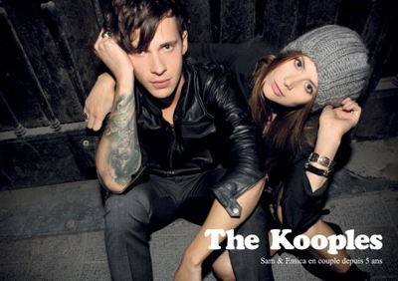
THE KOOPLES
The Kooples is an UK store

Slide 13
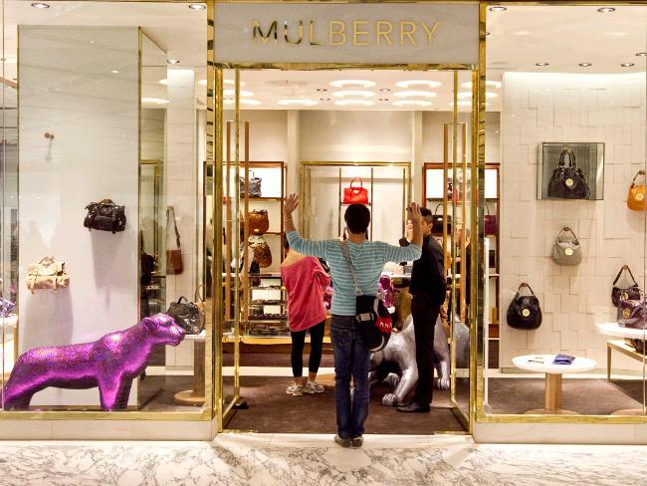
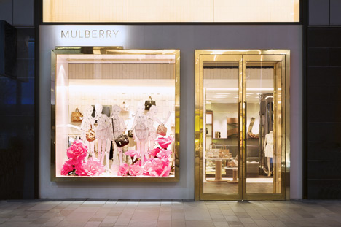
MULBERRY
Mulberry is a fashion company founded in England in 1971

Slide 14
Thanks for listening and watching!!!
Made by: Melita Doktor & Lucija Čačić 6.D
OŠ BUKOVAC

