Slide 1
SCHOOLs IN GREAT BRITAIN

Slide 2
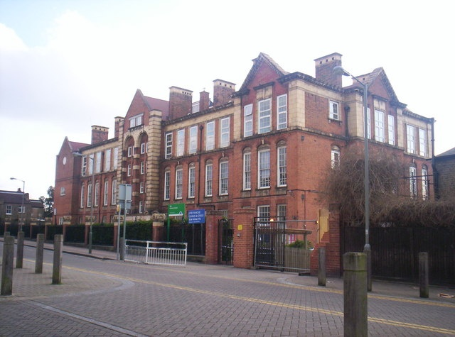
PRIMARY SCHOOL
Children in Britain start school when they are five years old. Primary school comes before secondary school and after preschool. They go to a primary school until they are eleven.
The school starts between 8.30 and 9.00 am and finishes at 4.00 pm. The school year starts in the first week of September and finishesi n the third
week of July. They have lunch in school canteen or bring snack from home.

Slide 3
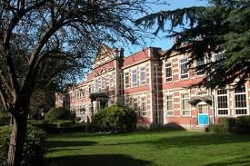
SECONDARY SCHOOL
After primary school they go to a secondary school. They can leave when they are sixteen. In the last two years of school they work towards a qualification called the General Certificate of Secondary Education.
Students stay at school after they are sixteen, they can go into the sixth form for two years. Here students usually study three subjects. At the end of the sixth form they take an examination called A-levels.

Slide 4
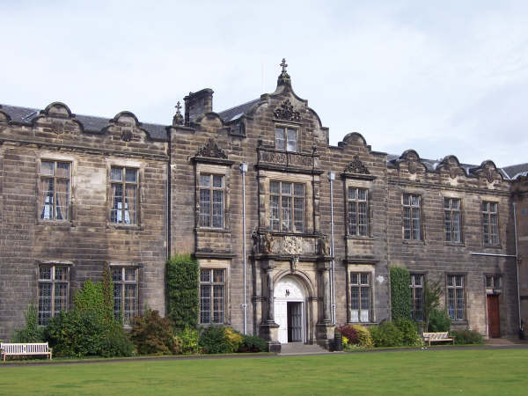
COLLEGES OR UNIVERCITIES
If they leave school when they are sixteen, young people can get a job or they can go to a collage. When A-level students are eighteen they leave school. They can then get a job, go to a collage or go to an university.

Slide 5
FAMOUS UNIVERSETIES
Oxford
Camebridge
Oxford University is the university in the English city of Oxford, founded in 1096. It is considered the oldest university in the English-speaking world and among the five best universities in the world. University of Cambridge and Oxford are sometimes together referred to as "Oxbridge". Both have great social and historical status and the centuries-old rivalry.
Students who graduate at Oxford, gain a shortcut Oxon., ex."John Smith, BA (Oxon.)"
University of Cambridge is the second oldest university in the world that runs continuously since its founding. From Cambridgeuniversity derive 87 Nobel Prize winners which is more than from any other university in world.

Slide 6
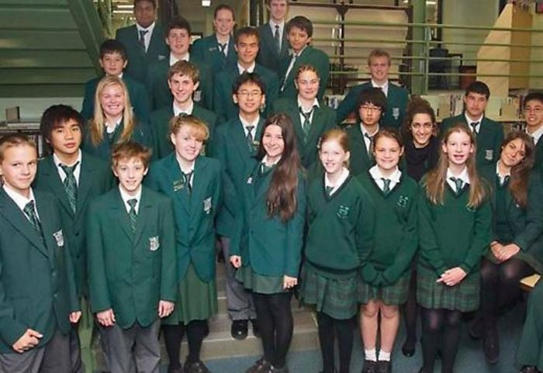
SCHOOL UNIFORMS
During the years uniforms played a big role in English society. The first school to introduce uniforms was Christ’s Hospital and it is the oldest uniform of any school.
Today they believes that uniforms support positive behavior and discipline, support for all races and protect children from social pressures.

Slide 7
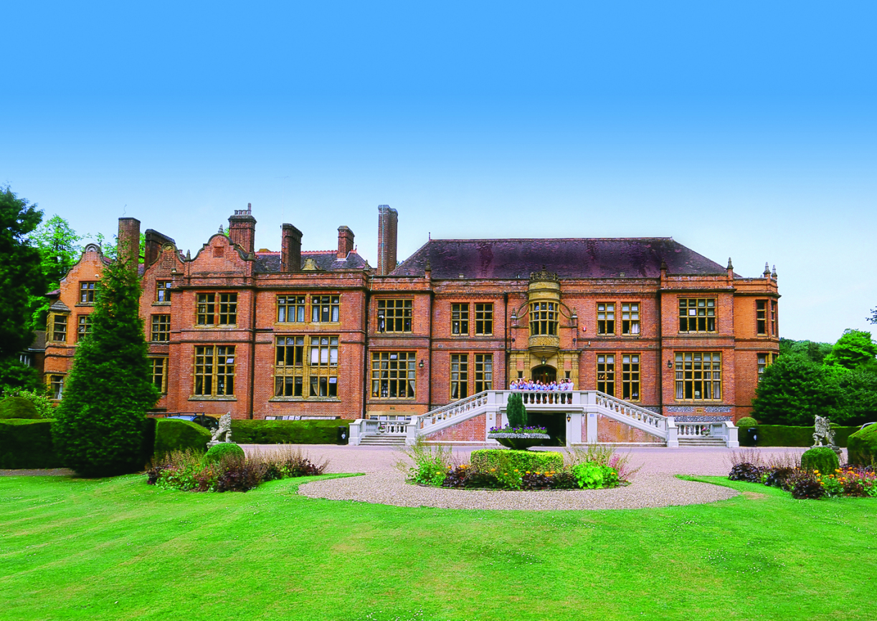
BOARDING SCHOOL
In U.K. some parents send theire children to boarding schools.They are very organized and cost a lot of money. Children in boarding school have uniforms and they spend the whole year in school. Only during breaks they go home.Today ,most pupils are not going to boarding schools.

Slide 8
THE END
Filip Posavac
Dorian Posavac
6.b
OŠ Bukovac

